Slide 1
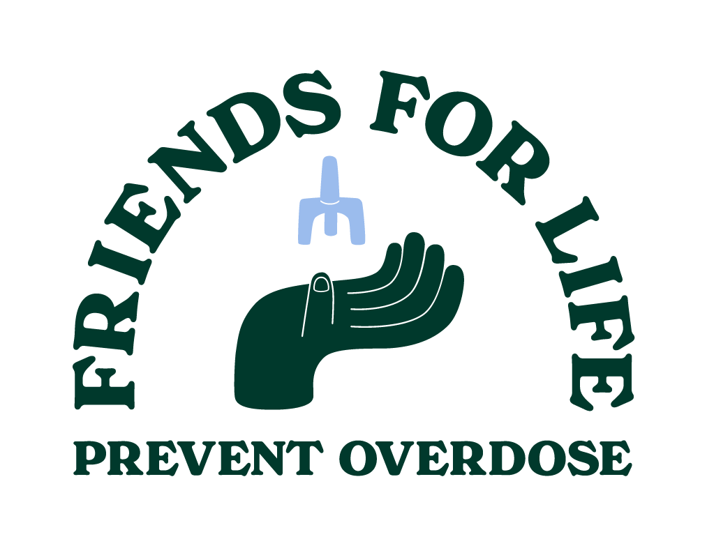

The facts about fentanyl
La realidad acerca del fentanilo
Notes:
SUGGESTED SCRIPT
Hello, and thank you for being with us tonight. My name is [name] and I work as a [job title] with [employer]. The presentation tonight is part of the "Friends for Life" campaign funded by the Washington State Health Care Authority. The goal of this presentation and the campaign as a whole is to inform people about ​
illicit fentanyl​
opioid overdoses​
the opioid overdose reversal medication naloxone (Narcan) and​
prevention strategies to help teens avoid opioids including fentanyl​

Slide 2
What we’ll cover
Lo que vamos
a cubrir
Basics about opioids, fentanyl, and naloxone (Narcan)​
What to know about the overdose crisis in Washington​
How to help teens avoid opioids and stay safe
Información básica sobre los opioides, el fentanilo y la naloxona (Narcan)
Lo que hay que saber
sobre la crisis de sobredosis
en Washington
Cómo ayudar a los adolescentes a evitar los opioides y a mantenerse a salvo
Notes:
SUGGESTED SCRIPT
Tonight, we're going to share the basics about opioids and fentanyl, including what you need to know about the overdose crisis in Washington state. We'll also cover specific prevention strategies to help the teens in your life avoid opioids altogether and give you information about naloxone (or Narcan), a medication that helps reverse an opioid overdose.

Slide 3
Basics about opioids
Conceptos básicos sobre los opioides
Regulated (legal) opioids: ​
  OxyContin​
  Vicodin​
  Morphine​
  Codeine​
  Fentanyl​
Unregulated (illicit) opioids: ​​
  Heroin​​
  Carfentanil ​​
  Illicit fentanyl​
Opioides regulados (legales): ​
  OxyContin​
  Vicodin​
  Morfina
  Codeína​
  Fentanilo​
Opioides no regulados (ilegales): ​​
  Heroína
  Carfentanil
  Fentanilo ilícito
Notes:
SUGGESTED SCRIPT
Some of you may already know the information I'll cover on these next few slides, but I want to briefly touch on the basics so we all have the same facts. ​
​
Opioids are a type of drug used to manage and relieve pain by binding to nerve receptors in the brain, spinal cord, and other organs. ​
​
Regulated (legal) opioids, like OxyContin or Vicodin, are often prescribed following surgeries or injuries or as part of cancer treatment. ​
​
Unregulated (illicit) opioids, like heroin, are sold as street drugs.​
​
You will see that there is a legal/highly regulated version of fentanyl and an illicit/unregulated version. Tonight, we will be focusing on illicit fentanyl. ​

Slide 4
Basics about opioids
Conceptos básicos sobre los opioides
Regulated (legal) opioids: ​
  Highly controlled​
  Manufactured in official labs​
  Dosage is specific and standard​
  Prescribed by medical professionals​
  Dispensed at pharmacies
Unregulated (illicit) opioids: ​​
  Uncontrolled​​
  Manufactured in underground labs​​
  Dosage is highly unpredictable​​
  Sold on the streets​
Opioides regulados (legales): ​
  Altamente controlados
  Fabricados en laboratorios autorizados
  La dosis es específica y estándar​
  Recetados por profesionales médicos
  Surtidos en farmacias
Opioides no regulados (ilegales): ​​
  No controlados
  Fabricados en laboratorios clandestinos
  Dosis muy impredecibles
  Se venden en la calle​
Notes:
SUGGESTED SCRIPT
There are several key differences between regulated (legal) opioids and unregulated (illicit) opioids. These key differences relate to:​
​
how and where the opioid is produced​
where and by whom it gets distributed​
These measures are designed to help keep people safe. ​
​
Part of what makes unregulated opioids like illicit fentanyl so harmful is that it is made in uncontrolled environments where the strength of each batch of pills, or even each individual pill, can vary dramatically. Some pills may contain very little illicit fentanyl, some contain lethal doses, and there's no way to tell them apart.​

Slide 5
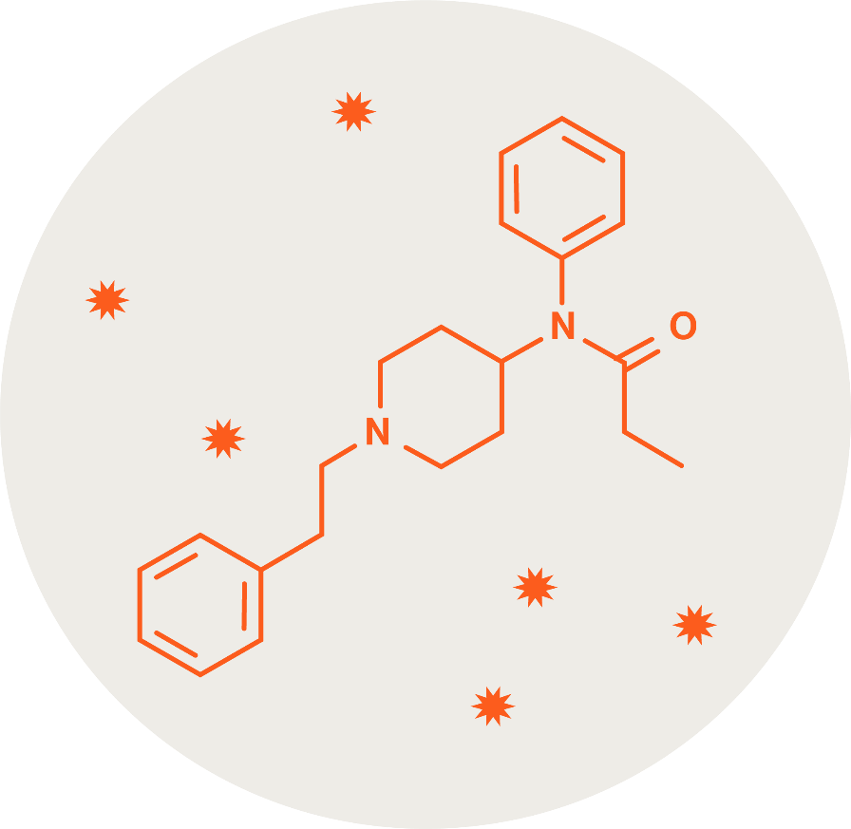
Basics about opioids
Conceptos básicos sobre los opioides
All opioids, whether regulated (legal) or unregulated (illicit), share some effects in common. They:
Relieve pain
Cause drowsiness/sleepiness
Depress, or slow down, breathing
Opioids can also be
habit-forming.
Todos los opioides, ya sean regulados (legales) o no regulados (ilegales), tienen algunos efectos en común y son los siguientes:
Alivian el dolor
Causan sueño
Deprimen, o desaceleran, la respiración
Los opioides también pueden crear adicciones.
Notes:
SUGGESTED SCRIPT
The main effect of any opioid is pain relief. Two side effects are drowsiness and slowed down breathing.
Often when someone is experiencing an opioid overdose, they appear to be sleeping, but they cannot wake up. Another sign a person has overdosed is that their skin begins to turn blue, gray, or purple, which is caused by a lack of oxygen from slow or no breathing.

Slide 6
Fentanyl is a powerful, fast-acting opioid
50 times stronger than heroin and
100 times stronger than morphine.
El fentanilo es un opioide potente y
de acción rápida,
50 veces más potente que la heroína y
100 veces más que
la morfina.
​​
Regulated (legal) fentanyl is used in medical settings​
Unregulated (illicit) fentanyl is sold on the streets ​​
  Pills can look like real prescription medication​
  Powder can be mixed into other illicit drugs like cocaine and MDMA ​
​​
El fentanilo regulado (legal) se utiliza en entornos médicos.
El fentanilo no regulado (ilegal) se vende en la calle
  Las pastillas pueden parecer a auténticos medicamentos con receta
  El polvo puede mezclarse con otras sustancias ilegales, como la cocaína y MDMA.​
Notes:
SUGGESTED SCRIPT
Fentanyl is a powerful, fast-acting opioid about 50 times stronger than heroin and 100 times stronger than morphine.​
​
Illicit fentanyl is sold on the streets, usually as a pill or powder. It can be pressed into pills that look just like real prescription OxyContin, Adderall, Xanax, Percocet, and more. These fake pill laced with fentanyl are nearly impossible to distinguish from the real prescription pills they resemble. ​
​
It can also be mixed into other illicit drugs like cocaine and MDMA.​
​
Because illicit fentanyl is so strong, a tiny amount can cause an overdose, and because it is fast-acting, those overdoses tend to set in very quickly. ​

Slide 7
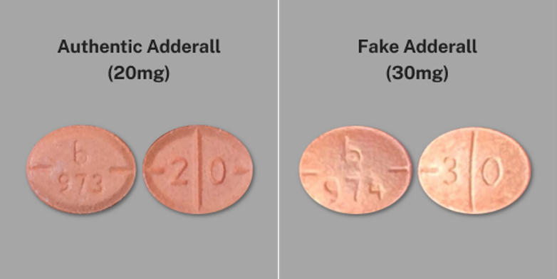
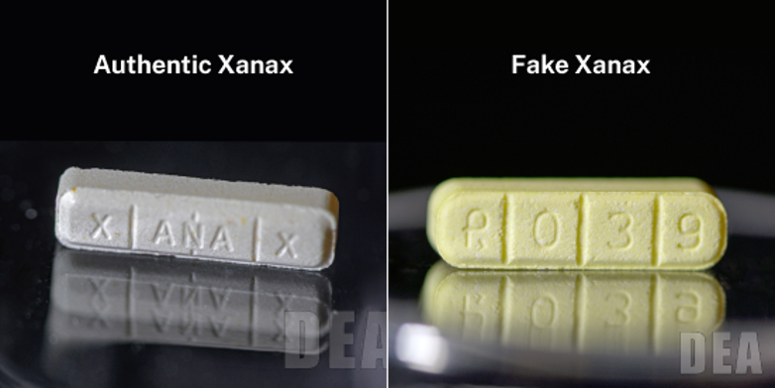
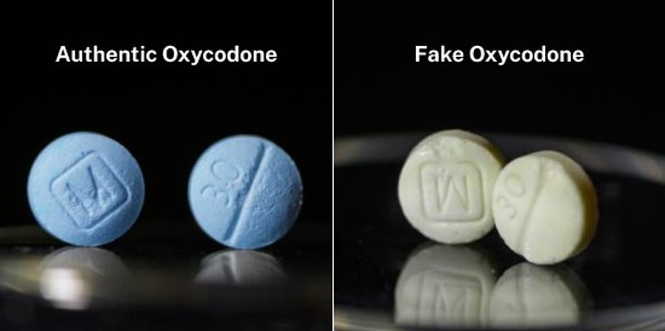
Prescription vs. fake pills
Pastillas con receta vs. pastillas falsas
Adderall auténtico
(20mg)
Adderall falso
(20mg)
Xanax auténtico
Xanax falso
Oxicodona auténtica
Oxicodona falsa
Source: DEA
Fuente: DEA
Notes:
SUGGESTED SCRIPT
These real-life examples, pulled from the Drug Enforcement Administration of the U.S., show how similar fake, fentanyl-laced pills look compared to the real prescription medication. Especially when you don't have the real thing to compare it to, these fake pills are so similar in their shape, size, and color that they are nearly impossible to identify as counterfeits.

Slide 8
The overdose crisis in Washington
La crisis
de las sobredosis
en Washington
Most overdose deaths in Washington involve fentanyl.​
​The rate of youth overdose has increased.​
Yet, the number of youth deaths from overdose remains relatively low.​
​Still, one life lost is one too many.​
La mayoría de las muertes por sobredosis en Washington están relacionadas con el fentanilo.
La tasa de sobredosis juvenil ha aumentado.
Sin embargo, el número de muertes de jóvenes por sobredosis sigue siendo relativamente bajo.
Aun así, una vida perdida es demasiado.
Source: DOH Overdose Dashboard
Fuente: DOH Overdose Dashboard
Notes:
SUGGESTED SCRIPT
Here's what you need to know about the overdose crisis in Washington state: ​
​
In Washington and across the U.S., illicit fentanyl and other powerful additives are making street drugs more unpredictable and harmful.​
​
The rate of youth overdose has increased in recent years, and illicit fentanyl is a big part of the reason why.​
​
HOWEVER, most teens are not actively seeking out or knowingly experimenting with opioids, including fentanyl. And the overall number of Washington minors who have died from a fentanyl overdose remains relatively low.​
​
Still, one life lost is one too many. Fentanyl is hurting the people we care about, and just by being informed and educating others, we can help keep one another safe.​
​
Here's what I want you to take away from this slide:​
The risks of illicit fentanyl are very real. Fentanyl is increasing overdose and death rates in every part of Washington.​
AT THE SAME TIME, most young people are not intentionally taking fentanyl. In fact, most young people report that they don't experiment with pills of any kind.​
BUT because illicit fentanyl is so harmful, it is still important for everyone (teens included) to understand the risks of illicit fentanyl and know how to avoid it.​

Slide 9
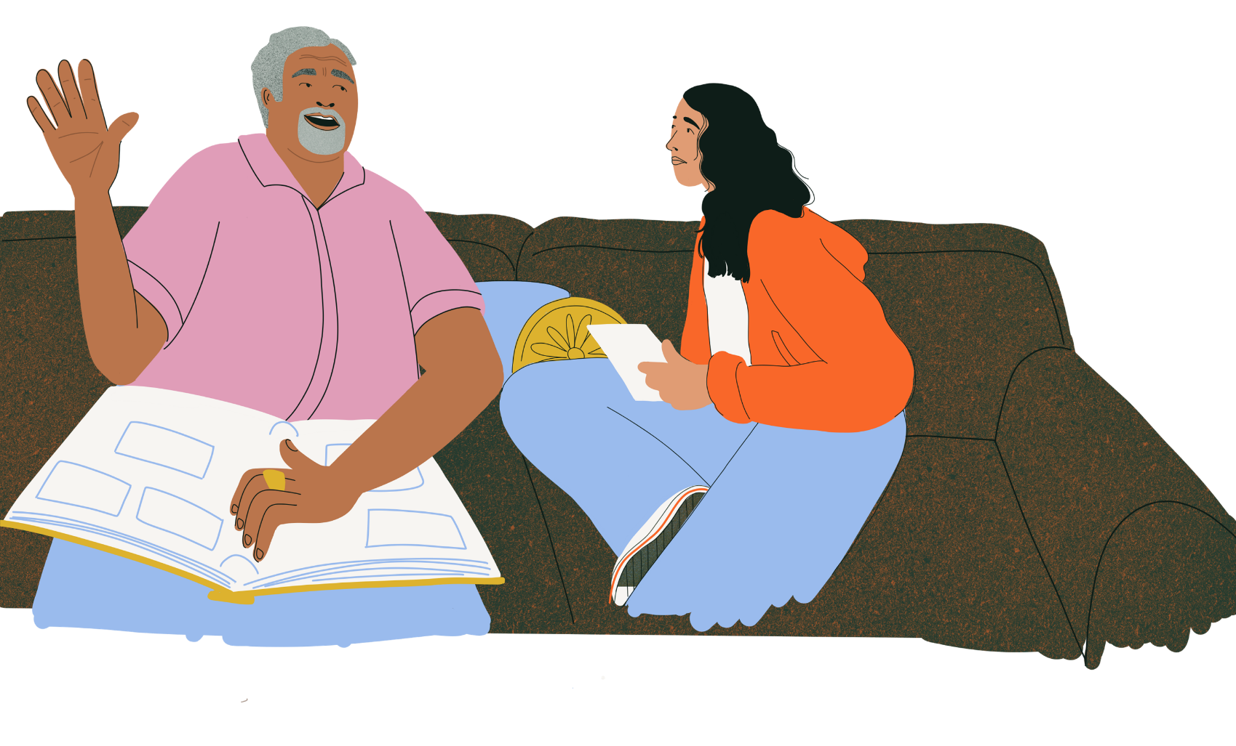
What you can do to help teens
¿Qué puede usted hacer para ayudar a los adolescentes?
Understand risk factors​
​Set expectations​
​Talk about fentanyl
​Teach refusal skills​
​Get to know their friends and
their friends' parents/caregivers​
​Help build healthy friendships​
Comprender los factores de riesgo
Establecer expectativas
Hablar sobre el fentanilo
Enseñar técnicas de rechazo
Conocer a sus amistades y a los padres o cuidadores de sus amistades
Ayudar a construir amistades sanas
Notes:
SUGGESTED SCRIPT
There's a lot you can do to educate the teens in your life about illicit fentanyl and prepare them to avoid any pressure they may face to experiment with drugs.​
​
This includes:​
Understanding potential risk factors​
Setting expectations​
Talking about fentanyl​
Teaching practical refusal skills​
Getting to know their friends and their friends' parents/caregivers​
Helping them build healthy friendships from a young age​

Slide 10
Understanding risk factors
Comprender los factores de riesgo
Mental health​
  Teens experiencing stress, anxiety,
  or depression may seek out pills to
  self-medicate and are likely to use alone.​​
Physical pain​
  Teens who have been injured or are experiencing physical pain may seek out pills to self-medicate.​
​Peer pressure​
  Teens may experiment in social settings with peers who are drinking, taking pills, or using other drugs.
Salud mental
  Los adolescentes que sufren estrés, ansiedad o depresión pueden buscar pastillas para automedicarse y es probable que las consuman solos.​​
Dolor físico
  Los adolescentes que han sufrido lesiones o dolor físico pueden buscar pastillas para automedicarse.
​Presión social
  Los adolescentes pueden experimentar en entornos sociales con compañeros que beben, toman pastillas o consumen otras drogas.
Notes:
SUGGESTED SCRIPT
Among the risk factors that may contribute to a teen experimenting with prescription pills (or what they believe are prescription pills), these risk factors tend to be the most common. ​
​
Some teens do take illicit fentanyl knowingly. But the most recent Healthy Youth Survey for Washington suggests less than 1% of all teens use prescription pills as a way to get high. ​
​
Other factors like mental health challenges and physical pain may also be reasons why teens seek out prescription pills that weren't prescribed to them. And this, of course, increases their risk of coming into contact with fake pills laced with illicit fentanyl. ​

Slide 11
Setting expectations
Establecer expectativas
Most teens trust their parents or caregivers when it comes to advice about not trying drugs.​
Fake pills are the most common way teens encounter fentanyl. ​
Talk with teens about not taking or sharing pills not prescribed to them.
La mayoría de los adolescentes confían en sus padres o cuidadores cuando se trata de aconsejarles que no prueben las drogas.
Las pastillas falsas son la forma más habitual en que los adolescentes se topan con el fentanilo.
Hable con los adolescentes para que no tomen ni compartan pastillas que no les hayan sido recetadas.
Notes:
SUGGESTED SCRIPT:
Most teens say they trust their parents or caregivers more than anyone when it comes to information and advice about not trying drugs. They consider you an expert, so what you say to them matters. ​
​
The majority of teens who encounter fentanyl do so accidentally – mistaking fake pills for real prescription OxyContin, Adderall, Xanax, or Percocet.​
​
They typically access these pills on social media apps like Snapchat or from friends who may or may not know that the pill has fentanyl in it.​
​
The most important expectation you can set with teens to reduce the risk that they encounter illicit fentanyl is to not take or share pills that have not been prescribed to them. Teens should know that any pill that wasn't prescribed to them by a doctor and picked up from a pharmacy may contain fentanyl and put them at risk of an overdose or death. ​
​
Reinforce that it is never safe or acceptable to take or share prescription pills that aren't theirs.​

Slide 12
Talking about fentanyl
Hablar sobre
el fentanilo
​Set expectations about not experimenting with pills or other drugs​.
​Show you care about their health, happiness, and wellbeing.
​Demonstrate that you are a reliable, trusted source of information​.
​Show you're paying attention and want to hear what they have to say​.
​Help them build skills to refuse offers to use or experiment with drugs.
Establezca expectativas para que no experimenten con pastillas u otras drogas.
Demuestre que se preocupa por su salud, felicidad y bienestar.
Demuestre ser una fuente de información fiable y de confianza.
Demuestre que está prestando atención y que quiere escuchar lo que tienen que decir.
Ayúdeles a desarrollar habilidades para rechazar ofertas de consumir o experimentar con drogas.
Notes:
SUGGESTED SCRIPT
One of the most powerful ways you can help the teens in your life stay safe is to start a conversation about illicit fentanyl. Talking about fentanyl does not make a teenager more likely to try it. In fact, the opposite is true. You are a huge influence, and your words matter.​
​
Keep in mind that successful conversations will:​
​
Set clear boundaries and expectations​
Show you care and that you're on their side​
Be open and honest. Ground your concerns in goals you both share, like their health, happiness, and wellness.​
Prove you are a reliable source of information​
Research suggests teens are incredibly interested in the "why" behind not taking or sharing pills. They will seek out that information, and if you don't serve as a reliable source for them, they may turn to less reliable places to get that information.​
Show you're attentive to what's going on in the world and in their lives​
This goes hand in hand with showing you care. When you show you are interested in their lives, they're more likely to share with you about what's really going on.​
Help them build realistic refusal skills​
Even if you believe your teens won't ever try pills, they will face pressure in their lives. These refusal skills work when it comes to saying "no" to more than just drugs. And, even if they never have to use them, they may be able to help a friend who does. ​
​

Slide 13
Talking about fentanyl
Hablar sobre
el fentanilo
​Pick a good time and place
Ask open-ended questions​
Really listen to their answers​
Stay calm and non-judgmental​
Avoid scare tactics. They don't work.​
Tell them how much you care
Keep the conversation going
Elija un buen momento y lugar
Haga preguntas abiertas
Escuche atentamente sus respuestas
Mantenga la calma y no juzgue
Evite las tácticas intimidatorias.
No funcionan.
Dígales lo mucho que le importan
Continúe la conversación
Notes:
SUGGESTED SCRIPT
Here are some things you can do to make sure the conversation goes well:​
​
Pick a time and a place where you can both focus.​
Think car rides, mealtimes, and other everyday moments.​
Ask open-ended questions and really listen.​
In fact, plan to listen more than you talk. Avoid giving a lecture.​
Stay calm and non-judgmental​
Nothing shuts down a conversation faster than feeling judged.​
Avoid scare tactics. They don't work.​
Feeling afraid gets in the way of learning new information. Focus on being informative rather than shocking or scary.​
Tell them how much you care.​
Teens need to know this conversation is coming from a place of love.​
Keep the conversation going.​
Several short conversations work better than one “Big Talk.” Keep checking in and sharing information.

Slide 14


What to say
¿Qué decir?
Have you heard about a drug called fentanyl? What have you heard?​
¿Has escuchado hablar de una droga llamada fentanilo? ¿Qué has escuchado?
WHY: You can learn what they've heard and share what you know.​
POR QUÉ: Así usted podrá saber lo
que han escuchado y podrá compartir
lo que sabe. ow.​
Notes:
SUGGESTED SCRIPT:
There are many ways to start a successful conversation with the teens in your life. These are suggestions to introduce the topic if you don't feel sure where to begin. ​
​
[REVIEW SUGGESTIONS ON THE SLIDE]

Slide 15


What to say
¿Qué decir?
I read an article/saw a video/heard
a report about fentanyl and wanted to talk to you about it.
He leído un artículo / visto un vídeo / escuchado un reportaje sobre el fentanilo y quería hablar contigo sobre ello.
Have you heard about a drug called fentanyl? What have you heard?​
WHY: Timely news lets you share information and talk about how you're feeling.​
POR QUÉ: Las noticias oportunas le permiten compartir información y hablar de cómo se siente.

Slide 16

What to say
¿Qué decir?
Sé que puede parecer seguro tomar una pastilla de alguna amistad, pero algunas de ellas pueden provocar una sobredosis o la muerte.
I read an article/saw a video/heard
a report about fentanyl and wanted to talk to you about it.
I know a pill might seem safe to take
from your friend, but some can cause
overdose or death.
I read an article/saw a video/heard
a report about fentanyl and wanted to talk to you about it.
WHY: You can outline the real risks of fake pills and set expectations around not sharing pills.
POR QUÉ: Puede explicar los riesgos reales de las pastillas falsas y establecer expectativas para que no compartan pastillas.

Slide 17
What to say
¿Qué decir?
Si alguna vez tienes preguntas sobre el fentanilo, o sobre cualquier droga, habla conmigo.
I know pill might seem safe to
take from your friend, but some can cause overdose or death.
If you ever have questions about fentanyl – or any drug – talk to me.
WHY: Teens need to know they can come to you with questions, and you'll be there to help.
POR QUÉ: Los adolescentes necesitan saber que pueden acudir a usted si tienen preguntas, y que estará allí para ayudarles.
Notes:
At the end of the day, conversations like this don't have to be "perfect." They just have to happen. ​

Slide 18
Teaching refusal skills
Enseñar técnicas de rechazo
Send a signal​
Pass the blame​
Offer an alternative​
Make an excuse​
Avoid the situation​
Be honest​
Be an advocate
Enviar una señal
Echar la culpa
Ofrecer una alternativa
Dar una excusa
Evitar la situación
Ser sincero
Ser un defensor
Notes:
SUGGESTED SCRIPT
Refusal skills are practical and concrete ways for teens to either learn to refuse offers to try pills or other drugs or to avoid the situation altogether. Walk your teens through these options and decide which ones they feel most comfortable planning to use in the event that they need to. Remind them that friends won't encourage them to take unsafe risks or pressure them to do something they don't want to.​
​
Send a signal​
Agree on a code your teen can text or call you with to come pick them up ASAP​
Pass the blame​
Be the "bad guy" your teen can use to get out of an awkward or harmful situation. They can say, "I'd be grounded for life if my parents/caregivers found out." ​
Offer an alternative​
This strategy is about suggesting a different activity than using pills or other drugs. Getting a bite to eat, taking a walk, playing video games, etc. are all viable options. ​
Make an excuse​
This strategy sounds like, "I have a huge test tomorrow," or "I have sports practice I can't miss," or "I have family coming in from out of town." Some excuse to explain why they don't want to try whatever they're being offered.​
Avoid the situation​
This strategy is simply about not going places or hanging around people who are likely to be trying pills or any other drugs. It could mean declining an invitation to a party or avoiding going to a certain person's house. ​
Be honest​
At the end of the day, "No." is a complete sentence. It's OK for your teen to be honest and say they simply do not want to try whatever they're being offered, no explanation necessary. This one may feel hard to do in the face of pressure, but it does work.​
Be an advocate​
Teens care what their friends think. If they're ever in a position to refuse an offer to use drugs, your teen can take it a step beyond these other skills and actually share what they know about the risks of trying pills or other drugs. By advocating for themselves, they will no doubt also be influencing others.

Slide 19
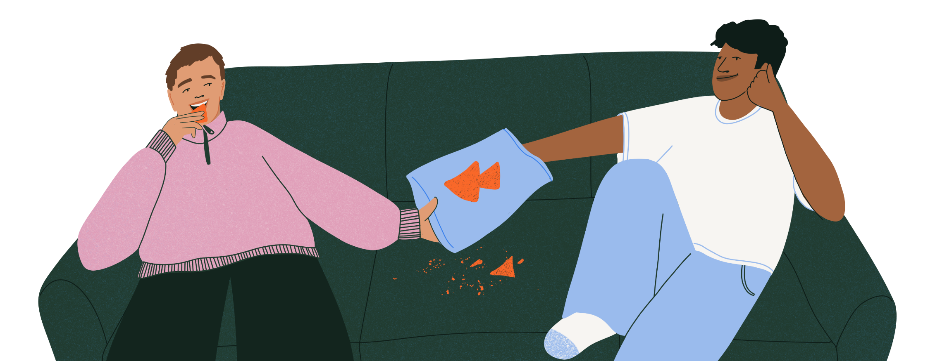
Building healthy friendships​
Construir amistades sanas
Friends play a big role in one another's success and safety. ​Teens need to know that friends:​
Care about each other​
Understand and respect each other​
Communicate openly and honestly​
Share goals and values​
Las amistades desempeñan un papel importante en el éxito y la seguridad de los demás. Los adolescentes deben saber que las amistades: ​​
Se preocupan los unos por los otros
Se comprenden y respetan mutuamente
Se comunican abierta y honestamente
Comparten objetivos y valores
Notes:
​SUGGESTED SCRIPT
When it comes to supporting your teens, you are not alone. Relationships, connection, and feeling like you belong are some of the most powerful protective factors that help keep people safe. Think of your teen's circle of friends as a literal protective force field surrounding them.
I can't really stress this enough. Information is powerful, absolutely. But healthy friendships – healthy connections – are the most powerful antidote to the factors that might put a teen at risk of trying pills or other drugs.
You can't control and aren't responsible for every friend your teen makes, but you can help them reflect on the qualities they want in a friend, what values are important to share (including not using pills or other drugs), and how they should expect to be treated in a healthy friendship.
You can also get to know the people they're spending time with. And get to know their friends' parents too. When and where it's appropriate, talk to them and share what you know about the risks of fake pills and illicit fentanyl.
Because you are also a part of your teens' friends' circle of people, and you can help protect them too.

Slide 20
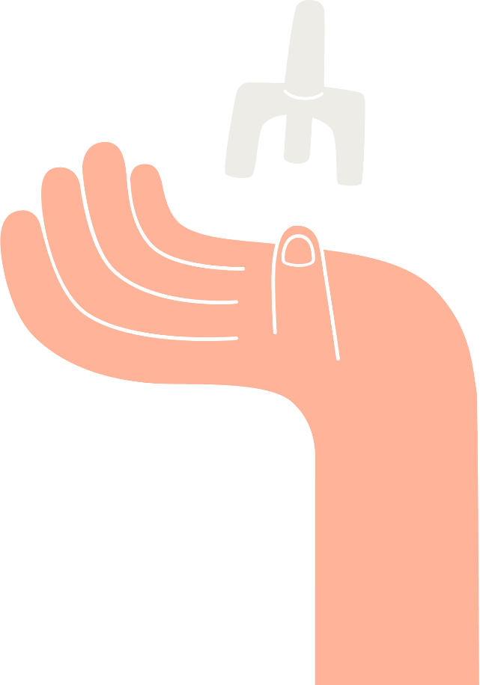

The basics of naloxone​
Aspectos básicos de la naloxona ​
Also known as Narcan​
​Reverses opioid overdoses​
​Available as a nasal spray or intramuscular injection​
​Washington state has
Good Samaritan laws
También conocido como Narcan
Revierte las sobredosis de opioides
Disponible en espray nasal o inyección intramuscular
El estado de Washington cuenta con leyes del buen samaritano
Notes:
SUGGESTED SCRIPT:
Naloxone, also known by the brand name Narcan, is a medication that reverses opioid overdoses. It is available most commonly as a nasal spray but also comes as an intramuscular injection.
Naloxone is simple, safe, and legal to carry and use. You don't need any special training to administer naloxone, there are easy to follow instructions on the package. The Federal Drug Administration recently approved two over-the-counter naloxone sprays that will be available at stores like CVS, Rite Aid, and Walgreens. Washington state also has laws called Good Samaritan Laws which protect people who call 911 in the event of an overdose from prosecution from simple drug possession. If you suspect someone has overdosed, you should ALWAYS call 911.

Slide 21
The basics of naloxone​
Aspectos básicos de la naloxona ​​
Naloxone (Narcan):​
​Blocks the effects of opioids to restore normal breathing
​Does not work to treat the effects of other drugs or alcohol​
​Has no effect on someone who is not on opioids​
​Is not habit-forming​
​Is the most effective tool to save lives ​
​
Naloxona (Narcan):​
Bloquea los efectos de los opioides y restablece la respiración normal
No sirve para tratar los efectos de otras drogas o del alcohol
No tiene ningún efecto en las personas que no se encuentran bajo los efectos de opioides.
No crea adicción
Es la herramienta más eficaz para salvar vidas
Notes:
SUGGESTED SCRIPT:
Our brains have opioid receptors. Naloxone (or Narcan) is a type of medication called an opioid antagonist. What that means is it blocks opioids from binding to the receptors in our brain. If someone is overdosing on opioids, naloxone will help reverse the effects and help them wake up/start breathing again.
Naloxone has no effect on someone who is not on opioids, meaning even if you give it to someone and they are not overdosing, you cannot hurt them by giving them naloxone. It also does not work to treat the effects of other drugs or alcohol. It only works for opioids like illicit fentanyl.
Naloxone is not habit-forming and has no side effects. However, if someone who regularly uses opioids experiences an overdose and receives naloxone, they may go into withdrawals.
Having naloxone as part of an emergency aid kit will not make teens more likely to try opioids. It may, however, save someone's life in the event of an emergency. It is the most effective tool we have to save lives, and you can make a difference just by having it on hand.

Slide 22
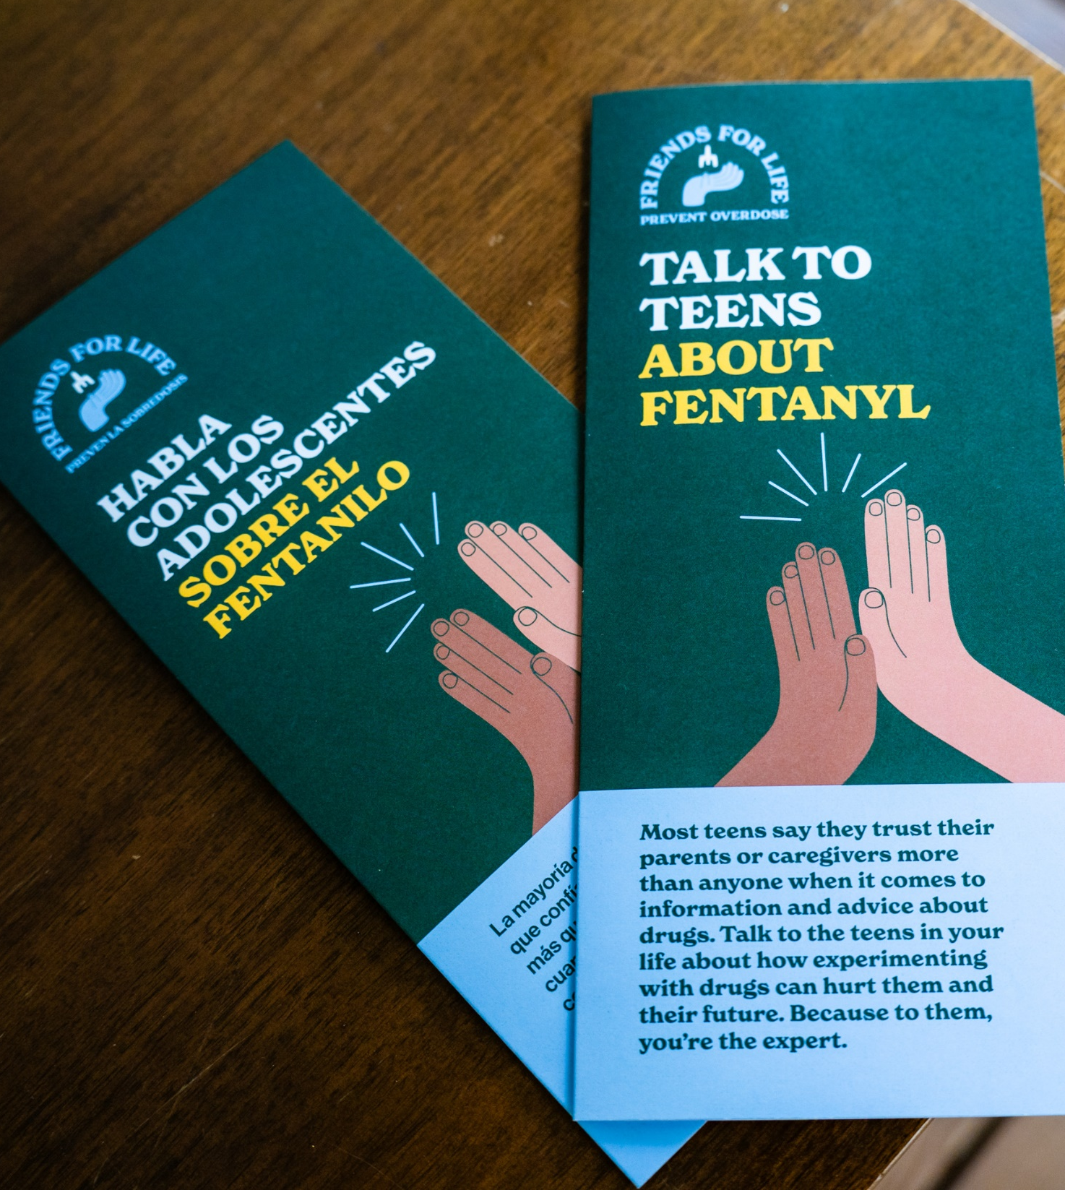
Additional resources
Visit WAFriendsForLife.com/toolkits for:​
Brochures ​
Conversation guides​
Videos
Recursos
adicionales
Visite WAFriendsForLife.com/ES/toolkits
para obtener:​
Folletos
Guías de conversación
Vídeos
Notes:
SUGGESTED SCRIPT:
You can find additional information and resources at the Friends for Life website at WAFriendsForLife.com. In the parent toolkit, you will find brochures, conversation guides, and videos with more details. The conversation guide and brochures are also available here in print tonight. Feel free to pick those up before you go.

Slide 23
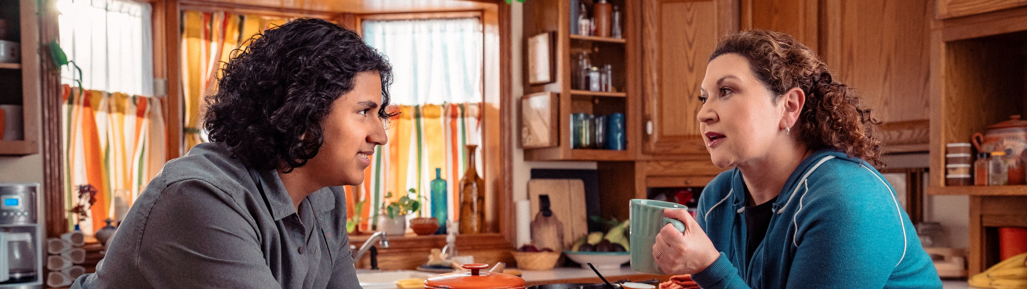
Questions?​
​Thank you!
¿Preguntas? ¡Gracias!
Notes:
SUGGESTED SCRIPT:
Thank you so much for being here tonight. With your help, we can put an end to youth opioid overdoses. I am happy to answer your questions at this time.

